Slide 1


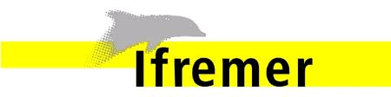

Automated Grid Generation for WAVEWATCH III
Prepared by Arun Chawla
Research Physicist, EMC/NCEP
Jose-Henrique Alves
Senior Research Scientist, SRG at EMC/NCEP
NOAA Center for Weather & Climate Prediction
5830 University Research Ct
College Park, MD 20740
Henrique.Alves@NOAA.gov

Slide 2
Outline
Covered in this lecture:
  The grids necessary for running WAVEWATCH III codes
  The reference data used for creating the grids
  The different modules of a grid generation software to develop the grids
  Additional changes needed to the grids to allow two – way communications between grids for multi-grid WAVEWATCH III

Slide 3
Motivation
  WAVEWATCH III requires 3 grids (1 necessary and two optional)
    A bathymetry grid (necessary)
    A land –sea mask grid (optional in WW III v 2.22, needed in multi-grid version of WW III)
    Obstruction grid to account for energy decay due to sub-grid blocking (optional)
  Development of these grids can be a fairly arduous task. This is specially true for multi-grid version of WW III where grid consistency across overlapping grids is necessary for accurate two – way coupling.
  To facilitate this we developed a set of algorithms that can automatically create accurate grids with minimal input from the user.
  The necessary tools have been developed using MATLAB.

Slide 4
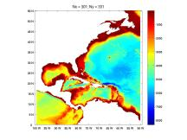
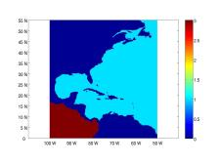
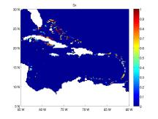
MODULES
Step 1: Build a bathymetric grid from a high resolution base bathymetry
Step 2: Create an appropriate land / sea mask to accurately depict coast lines
Step 3: Mask out un-necessary water bodies
Step 4: Generate obstruction grids for unresolved islands
Step 5: Identify nodes for exchanging boundary information (multiple-grid only)

Slide 5
Reference Data
  Two types of high resolution reference data available
    A global high resolution bathymetry data set
      ETOPO2 from the National Geophysical Data Center
        2’ arc length global relief bathymetry data set
      ETOPO1 from the National Geophysical Data Center
        1’ arc length global relief bathymetry data set
    A global shoreline database in the form of polygons (GSHHS - Global Self-consistent Hierarchical High-resolution Shoreline)
  Algorithms will be designed to meld the high resolution bathymetry with the shoreline database to develop the optimum grids.

Slide 6
Subroutines
  A grid generation routine
    Generates a grid from base bathymetric data set. We use global ETOPO2/ETOPO1 bathymetry netcdf files. (NOTE: To use this routine your matlab should be able to handle netcdf files. Capability is available as open source)
  A boundary extraction routine
    Extracts a subset of boundaries from a global set of polygon boundaries (GSHHS)
  A land-mask routine
    Blends the bathymetric data with the coastal boundaries to develop an accurate land-sea mask
  A water body routine
    Groups the wet cells into different water bodies (each having a unique id)
  A sub-grid obstruction routine
    Develops sub-grid obstruction matrices in x and y direction for wet cells

Slide 7
Flow Chart
High resolution grid
(e.g. ETOPO2)
GSSHS boundary polygons
(5 resolution levels)
Optional land mask
polygons
Grid generator
Boundary extractor
lat
lon
depth
Create mask
Boundary check
bound
mask
Separate water bodies
Create Wave Watch III files
Generate obstruction grid
Depth, obstruction
and mask data
Sx,Sy

Slide 8
Putting it together
Reference_data/
(base bathymetry and
coastal polygons)
bin/
(individual matlab subroutines)
GRIDGEN/
(Parent directory)
examples/
(Templates of master scripts used to generate grids)

Slide 9
Grid Generation Routine
  Routine uses 2D averaging to interpolate the higher resolution (reference) grid at the lower resolution
  Averaging carried out over all the reference “wet cells” that lie within a grid cell
  If the proportion of reference wet cells is less than user specified cut-off (ranging between 0 and 1) then the grid cell is marked dry.
  Averaging filters out higher spatial frequencies and prevents aliasing
Grid points
Grid cell
Reference grid points
Reference grid cell

Slide 10
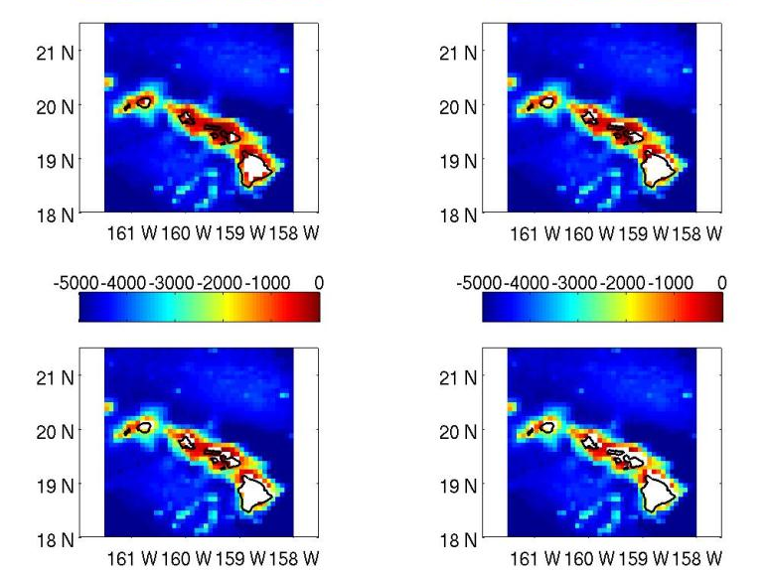
Bathymetry (Hawaiian islands) using different cutoffs for proportion of wet cells
0.1
0.4
0.7
0.9

Slide 11
Boundary extraction routine
  Uses the GSHHS (Global Self-consistent Hierarchical High-resolution Shoreline) polygon database.
  High resolution data is available as mat files at 5 resolutions
    Full
    high (0.2 km)
    intermediate (1 km)
    low (5 km)
    coarse (25 km)
  Only accounts for land – sea boundaries (ignores lakes)
  Properly splits boundaries that are intersecting grid domain boundary
    Important to properly close boundaries for land masks and sub grid obstructions

Slide 12
Improperly closed boundaries

Slide 13
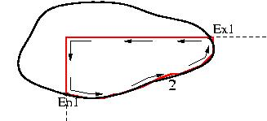
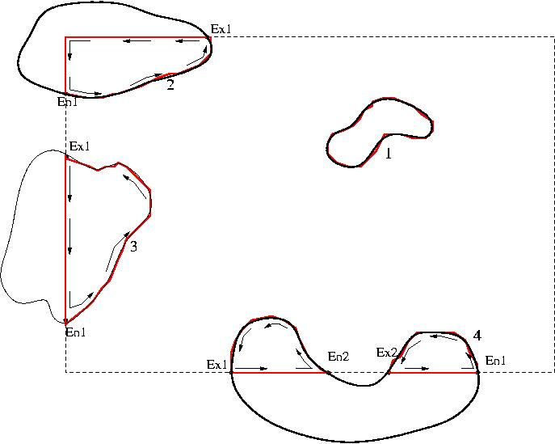
Splitting a boundary properly

Slide 15
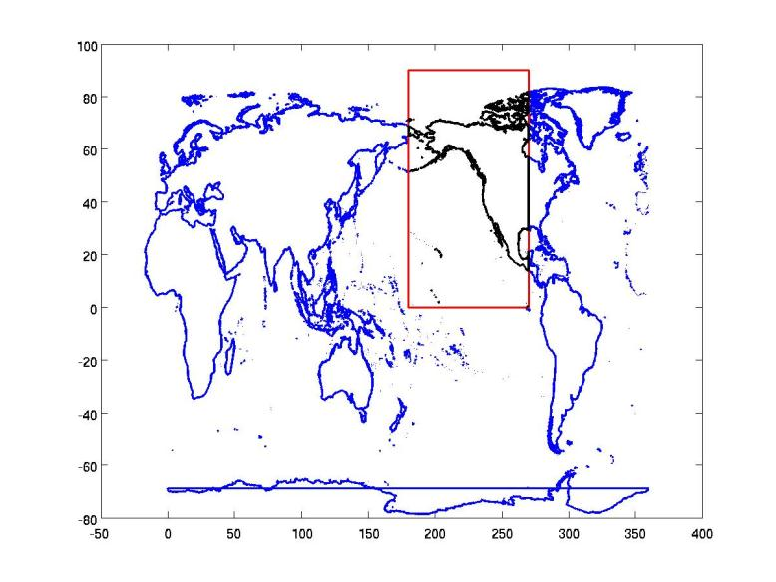
Full Resolution Global Boundary
Global boundaries
Grid domain
Sub-set boundaries

Slide 16
Land-sea mask routine
  A first order land mask (based on a depth cutoff) is determined
  The land mask routine then
    Checks all wet cells near the boundaries
    Switches wet cells to dry if a proportion of cell within the boundary > user specified cutoff (currently set at 0.5)
  Land mask routine needed to
    Account for land masses not present in base bathymetry grid
    Resolve discrepancies between shoreline data base and base bathymetry shorelines
    Account for additional polygons

Slide 17
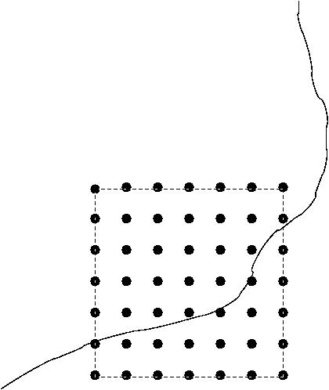
To compute proportion of cell inside boundary
  Equally spaced points spread throughout the cell
  Determine number of points enclosed within boundary
  Number of points inside boundary/Total number of points

Slide 18
Land-Sea Mask (Bahamas 15 min grid)
Red – Wet Cell
Blue – Dry Cell
White – Wet cell switched to dry cell

Slide 19
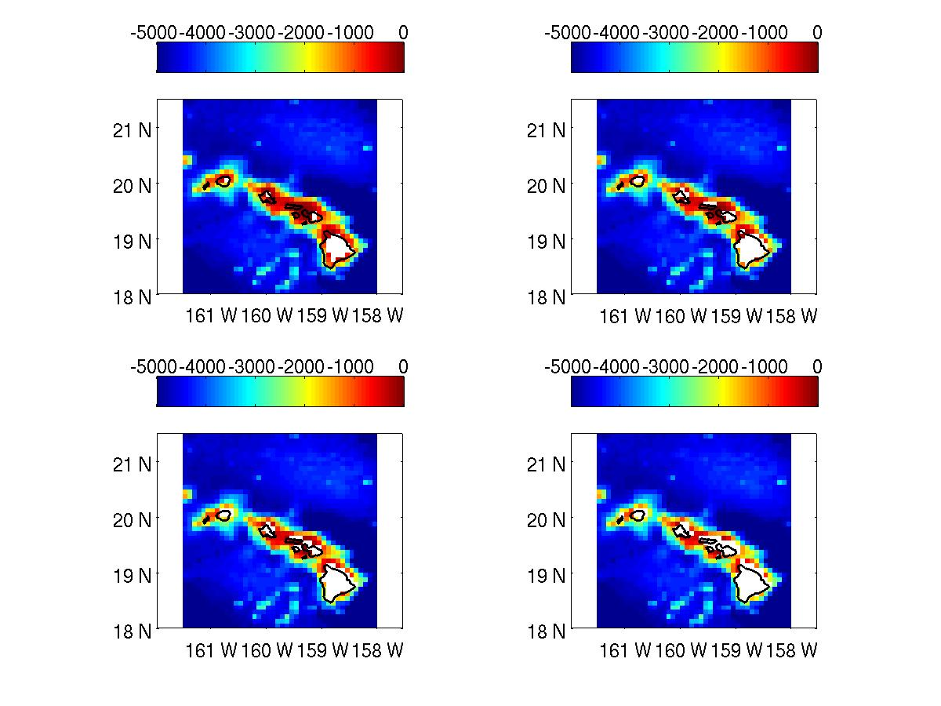
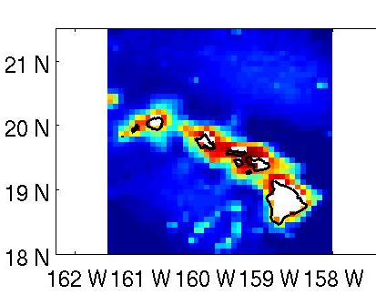
Depth (0.1)
Depth + Mask

Slide 20
Optional
Boundary Splitting
  Mask cleaning requires checking parts of cell being inside/outside a boundary
  For very large boundaries this can be a very cumbersome process
  An optional algorithm splits up the larger boundaries into more manageable smaller boundaries.
  Significantly speeds up the mask cleaning algorithm

Slide 21
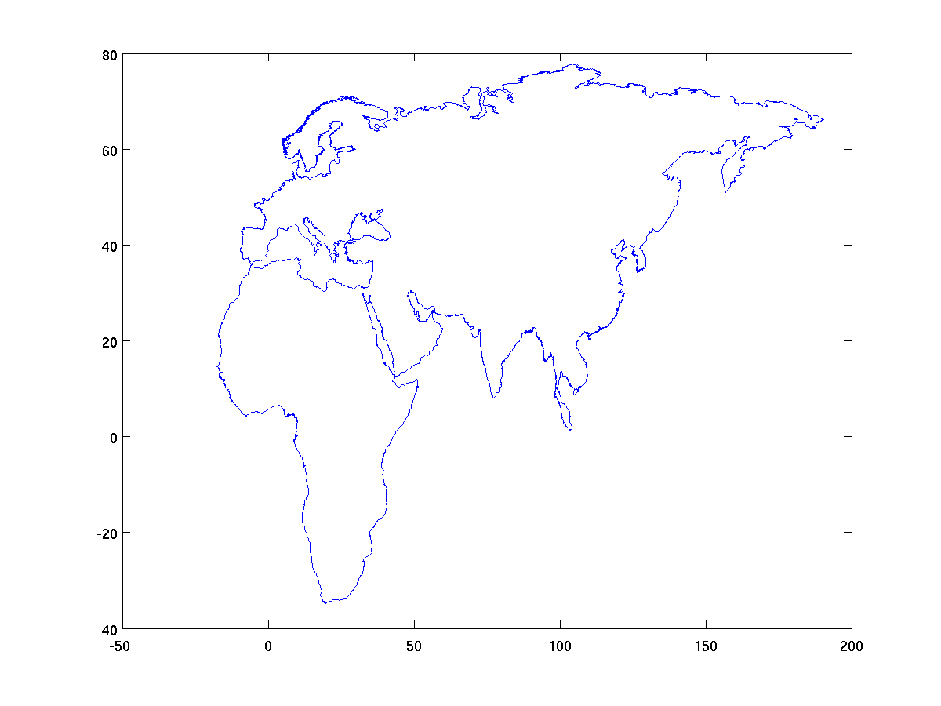
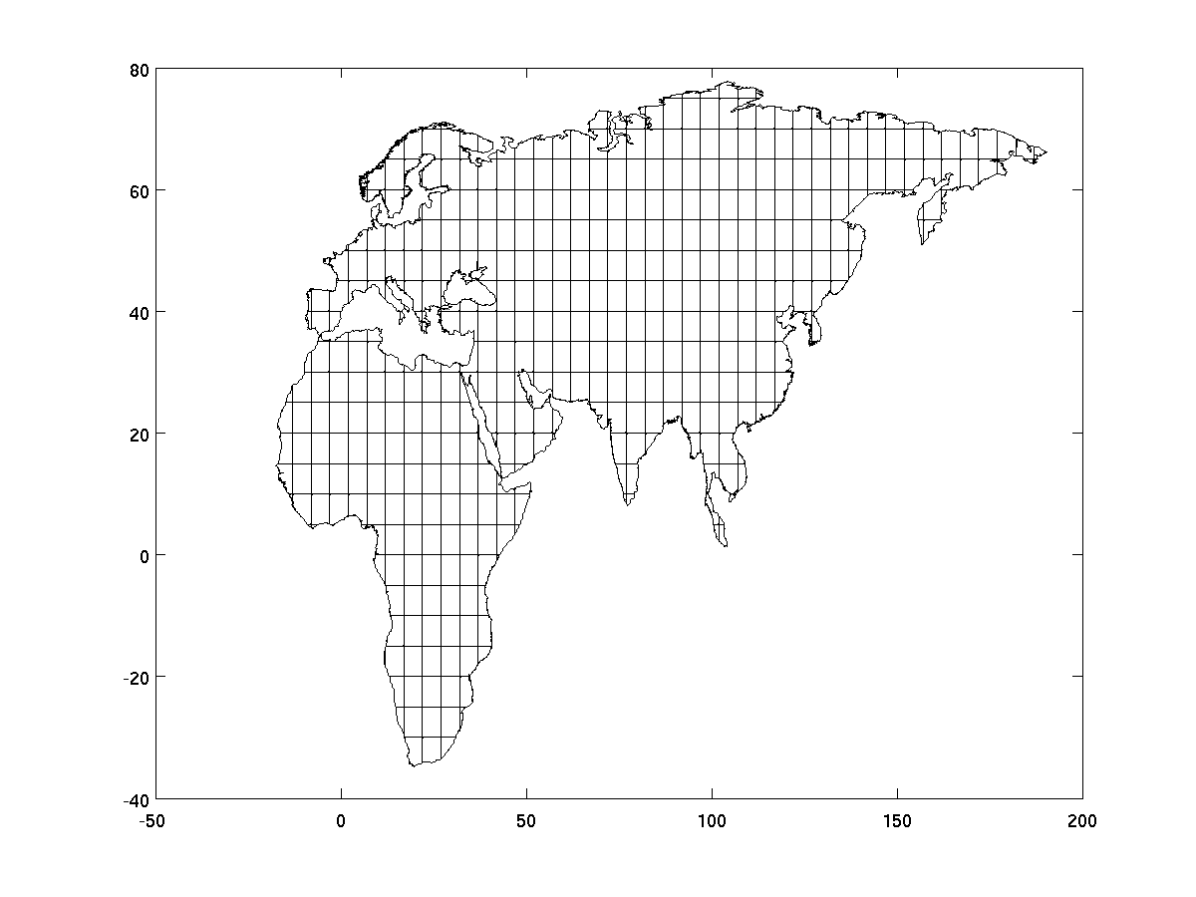
Boundary Splitting

Slide 22
Wet cell clean up routine
  Cycle through all the wet cells and flag all connected cells with the same id
  Independent water bodies have different ids
  Function returns an id map that allows users to switch cells of a particular water body from wet to dry
  Switching of cells can either be done inside the routine with a flag option, or outside by the user

Slide 23
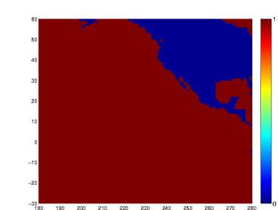
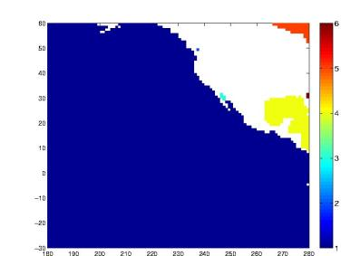
Wet Cell clean up (contd.)
  Initialize all wet cells as unmarked
  Starting from first unmarked cell with marker value at 1, mark all connected wet cells with the same marker
  If more unmarked cells then increment marker by 1 and repeat step 2.
  Keep repeating steps 3 and 2 till no longer unmarked wet cells
  End result is a mask map with the wet cells grouped into independent water bodies

Slide 24
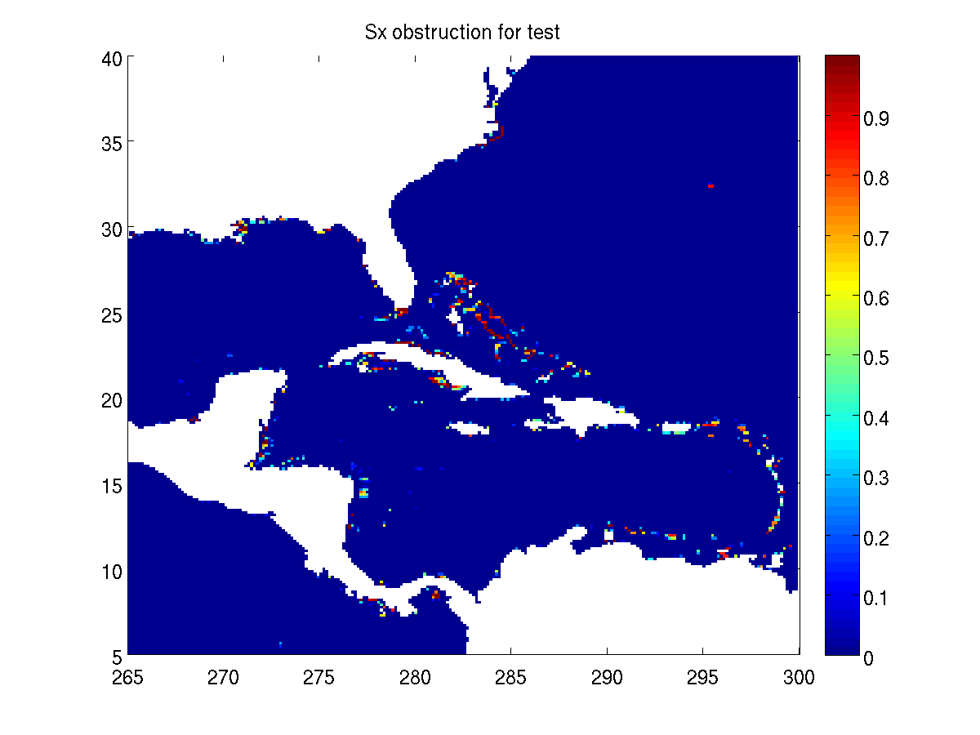

Obstruction grid algorithm
  Start from the final land – sea mask and boundary polygons (not the split polygons)
  Following the algorithm outlined in obstruction grid presentation build the obstruction grids for all the wet cells
  Assign obstructions next to dry cells to zero (to prevent spurious attenuation of wave energy)

Slide 25
At this point
  The grid generation software has created
    A bathymetric grid
    A final land – sea mask
    A pair of obstruction grids associated with the land – sea mask and (unresolved) boundaries within the grid
  When using WW-III in single grid mode this is all the information needed to create model definition files
  When using WW-III in multiple grid mode with two – way nesting between the grids further considerations have to be made that will be outlined next
  If building multiple grids, repeat steps till now for each of the individual grids before proceeding to the next step

Slide 26
Multi-grid algorithms
Additional changes to support two – way nesting
  Two way nesting in WW-III occurs as follows
    Boundary information from low resolution grids to high resolution grids
    Grid cell averaging from high resolution back to low resolution
    Grid resolution across overlapping grids of similar resolution
  In multi-grid WW-III, masks can have a value of 0 (land), 1 (ocean), 2 (boundary ; for data transfer from low resolution grids) and 3 (undefined ; outside the domain).
  Two additional algorithms to modify the masks for multi-grid WW-III
    A mask modifying algorithm that identifies boundary positions
    A mask reconciliation algorithm

Slide 27
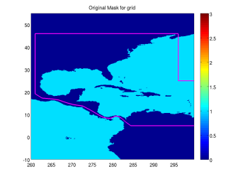
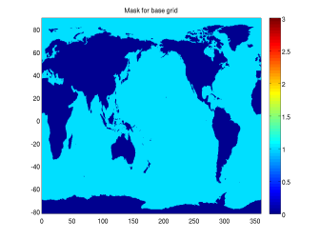

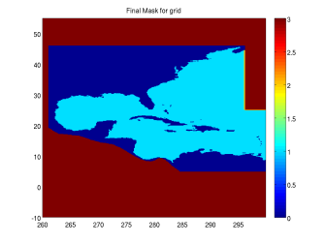
Modifying mask

Slide 28
Modifying masks
  Once grid information for all the individual grids have been developed, the modify mask routine can be used with pairs of base and higher resolution grids to modify masks for exchange of information from low resolution to high resolution
  Exchange of information from high to low resolution does not occur at a boundary so mask does not need to be modified
  Lowest resolution grid also does not need the mask to be modified
  If using the entire higher resolution grid (instead of carving out a domain inside the grid) then the polygon is defined by the corners of the grid
  For overlapping grids with similar resolution (where data is reconciled) a common overlap area has to be defined

Slide 29
Overlapping grids principle
Overlaping length = stencil_width * global_time_step/CFL_time_step + stencil_width*global_time_step/CFL_time_step+1
Grid 1
Grid 2

Slide 30
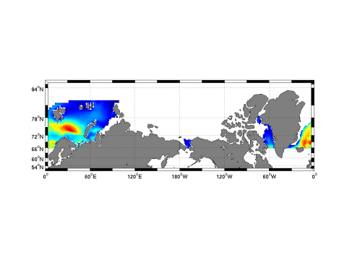
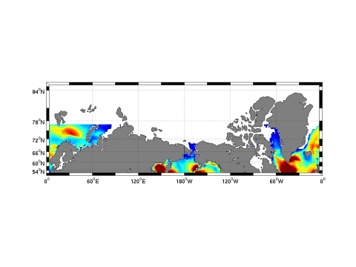
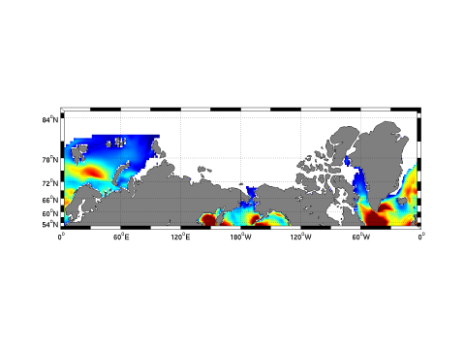
Overlapping grids
Grid 1 extends from 65N to 82 N
Grid 2 extends from 77.5S to 77.5 N
Putting it together …

Slide 31
Overlapping grids
  If there is not enough overlapping domain in overlapping grids of similar resolution the WW-III model will fail
  Since the minimum required domain width is a function of the global and CFL time steps in the respective grids, changing any can have an important impact on required overlapping domain width
  Land – sea masks in the two grids with overlapping domains has to be similar
  An optional land – sea mask reconciliation algorithm has been developed
    Compares two sets of masks in an overlapping domain
    If the mask at any location are different then they are both set to land values (0)

Slide 32
The end
End of lecture

